Slide 1


CS-429 Introduction to Data Science
Instructor: Mubahir Iqbal
Fall 2024

Slide 2
Supervised Machine Learning
K Nearest Neighbour

Slide 3
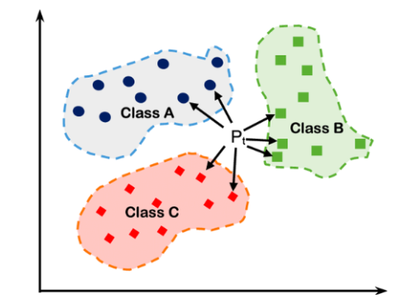
K Nearest Neighbour (KNN)
KNN is a simple and widely used machine learning algorithm for classification and regression tasks.
It is called a “lazy learner” because it doesn’t require a training phase; instead, it memorizes the dataset and makes predictions during testing.
It works by comparing a data point to its nearest neighbors and using their labels to predict the label for the new point.
It mimics how humans make decisions based on the people or objects around them.

Slide 4
K Nearest Neighbour (KNN)
It is simple and natural.
Works well on a small dataset
But slower for large datasets.
Sensitive to irrelevant features or outliers (scaling/normalization is important).
Examples:
Handwriting recognition.
Recommender systems.
Customer segmentation.
Spam Detection.
Medical Diagnosis

Slide 5
History of KNN
KNN was first created by Evelyn Fix and Joseph Hodges in 1951 as part of a study for the US military.
In 1967, Thomas Cover and Peter Hart improved the method and published a paper on “Nearest Neighbor Pattern Classification”.
Nearly 20 years later, James Keller improved the algorithm by creating a “fuzzy KNN” that reduces errors.
Name | Date
Evelyn Fix | 1904 ~ 1965
Joseph Lawson Hodges Jr. | 1922 ~ 2000
Thomas Cover | 1938 ~ 2012
Peter E. Hart | 1941 ~ Alive

Slide 6
Steps in KNN algorithm
Choose the value of K (number of neighbors).
Calculate the distance between the new data point and all existing data points.
Common distance metrics:
Euclidean Distance
Manhattan Distance
Minkowski Distance
Identify the K nearest neighbors (smallest distances).
Vote for the majority label (for classification) or average the values (for regression).
Assign the predicted label or value to the new data point

Slide 7
Steps in KNN algorithm
Assign the k value (k=5)
Calculate Distance (Euclidean)
Find the top k (5) nearest neighbors
Vote for the majority label of these neighbors
Assign the predicted label or value to the new data point

Slide 8
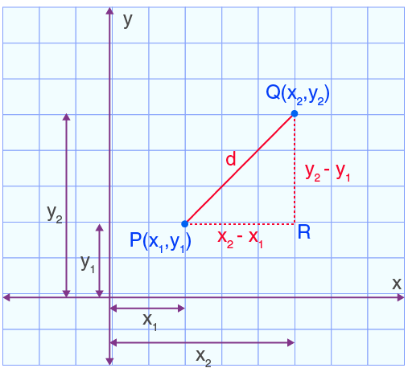
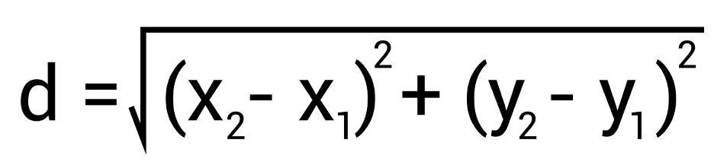
Euclidean Distance
Formula
P(2, 3) = (x1, y1)
Q(6, 8) = (x2, y2)
d = 6.4031242374

Slide 9
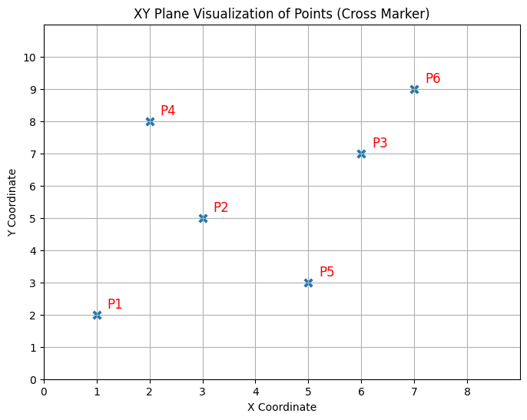
Example (Euclidean Distance)
Let’s define 6 points on the XY plane:
𝑃1=(1,2)
𝑃2=(3,5)
𝑃3=(6,7)
𝑃4=(2,8)
𝑃5=(5,3)
𝑃6=(7,9)

Slide 10
Example (Euclidean Distance)
Let’s find distance:
𝑃1=(1,2)
𝑃2=(3,5)
Where:

Slide 11
Example (Euclidean Distance)
Between points | Distance
d(P1, P2) | 3.6056
d(P1, P3) | 7.0711
d(P1, P4) | 6.0828
d(P1, P5) | 4.1231
d(P1, P6) | 9.2195
d(P2, P3) | 3.6056
d(P2, P4) | 3.1623
d(P2, P5) | 2.8284
d(P2, P6) | 5.6569
d(P3, P4) | 4.1231
d(P3, P5) | 4.1231
d(P3, P6) | 2.2361
d(P4, P5) | 5.831
d(P4, P6) | 5.099
d(P5, P6) | 6.3246
# Define points as (x, y)
points = [(1, 2), (3, 5), (6, 7), (2, 8), (5, 3), (7, 9)]
point_names = ["P1", "P2", "P3", "P4", "P5", "P6"]
# Calculate Euclidean distances
distances = []
for i in range(len(points)):
for j in range(i + 1, len(points)):
p1 = points[i]
p2 = points[j]
distance = np.sqrt((p2[0] - p1[0])**2 + (p2[1] - p1[1])**2)
distances.append(f“d(P{i+1}, P{j+1}) : {distance:.2f}")
# Print distances
for d in distances:
print(d)

Slide 12
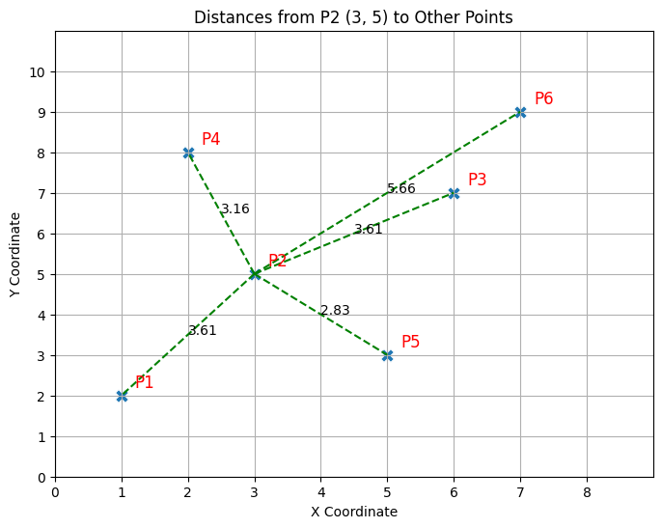
Example (Euclidean Distance)
Between points | Distance
d(P1, P2) | 3.6056
d(P2, P3) | 3.6056
d(P2, P4) | 3.1623
d(P2, P5) | 2.8284
d(P2, P6) | 5.6569
Which one is the closest point?

Slide 13
Example (Euclidean Distance)
Sorted values
Between points | Distance
d(P2, P5) | 2.8284
d(P2, P4) | 3.1623
d(P1, P2) | 3.6056
d(P2, P3) | 3.6056
d(P2, P6) | 5.6569

Slide 14
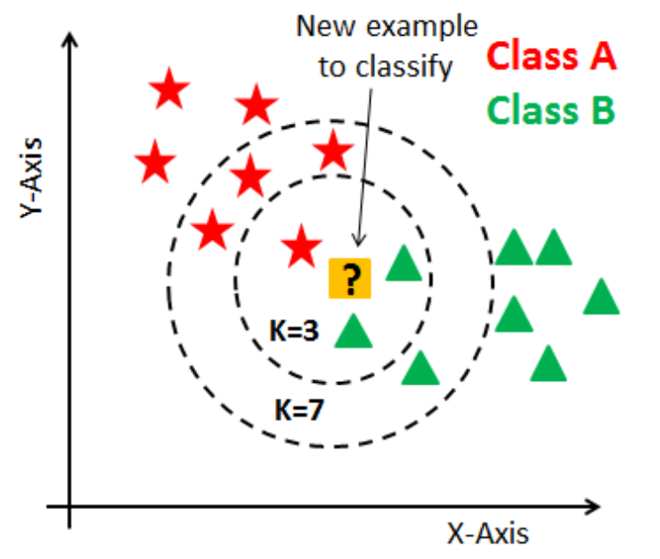
How to choose value of K
Low K values: Focus only on a few nearest points; this may lead to overfitting.
High K values: Consider more neighbors, but risk underfitting as the decision becomes too generalized.
Choose K as an odd number, larger than the number of classes, to avoid ties in classification.
What do you mean by avoiding ties in classification?

Slide 15
Python code for KNN
Import of value of number of neighbors
from sklearn.neighbors import KNeighborsClassifier
knn = KNeighborsClassifier(n_neighbors=3)
knn.fit(X_train, y_train)
y_pred = knn.predict(X_test)

Slide 16
Datasets for KNN practice
Iris Dataset
Classifies flowers into three species based on sepal and petal dimensions.
Link: iris.csv
Zoo Dataset
Classifies animals based on features like fur, feathers, and aquatic.
Link: Zoo - UCI Machine Learning Repository
Titanic Dataset
Predicts survival on the Titanic based on passenger details like age, sex, and class.
Link: datasets/titanic.csv at master · datasciencedojo/datasets

Slide 17
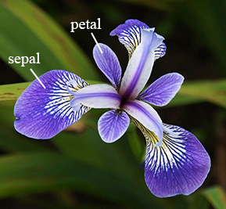
Example (Iris Dataset)
The Iris dataset was introduced by Ronald Fisher in 1936.
Dataset contains 150 records/samples.
The dataset is used to classify different species of the Iris flower based on their physical measurements.
Features:
Sepal length (in cm)
Sepal width (in cm)
Petal length (in cm)
Petal width (in cm)

Slide 18
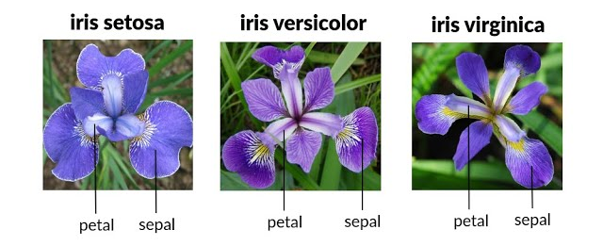
Example (Iris Dataset)
Target Variable: The species of the flower, which can be one of three classes:
Iris Setosa (0)
Iris Versicolor (1)
Iris Virginica (2)

Slide 19
Example (Iris Dataset)
sepal.length | sepal.width | petal.length | petal.width | variety
5.1 | 3.5 | 1.4 | 0.2 | Setosa
4.9 | 3 | 1.4 | 0.2 | Setosa
4.7 | 3.2 | 1.3 | 0.2 | Setosa
4.6 | 3.1 | 1.5 | 0.2 | Setosa
7 | 3.2 | 4.7 | 1.4 | Versicolor
6.4 | 3.2 | 4.5 | 1.5 | Versicolor
6.9 | 3.1 | 4.9 | 1.5 | Versicolor
6.5 | 3 | 5.8 | 2.2 | Virginica
7.6 | 3 | 6.6 | 2.1 | Virginica
4.9 | 2.5 | 4.5 | 1.7 | Virginica

Slide 20
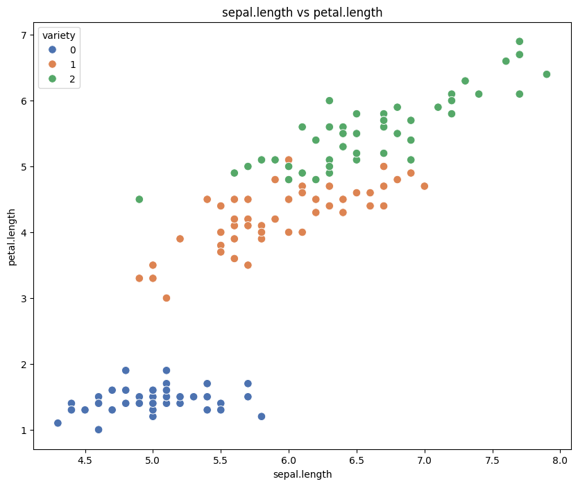
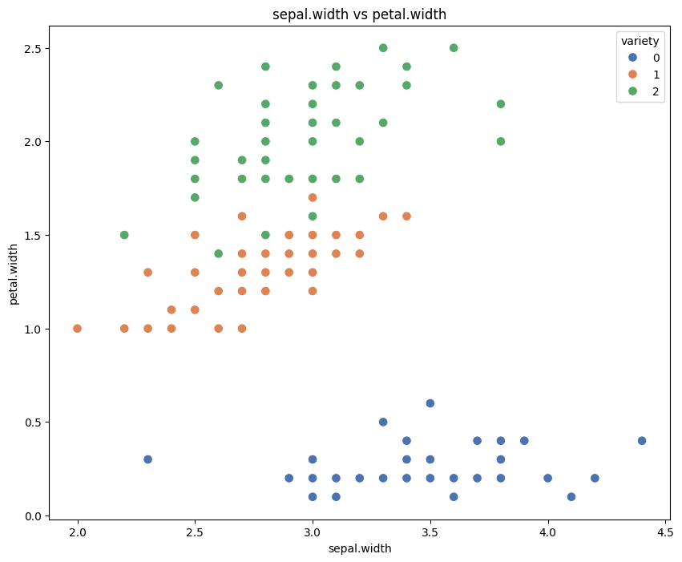
Example (Iris Dataset)
Some visualization plot using EDA process

Slide 21
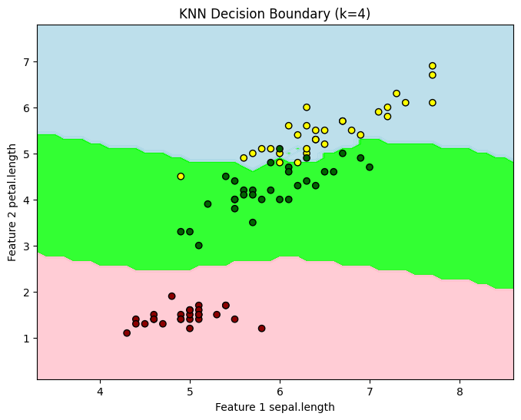
Example (Iris Dataset)
k = 4 # Number of neighbors
knn = KNeighborsClassifier(n_neighbors=k)
# Use only two features for visualization
firstFeatureIndex = 0
secondFeatureIndex = 2
X_train_vis = X_train.iloc[:, [firstFeatureIndex, secondFeatureIndex]]
knn.fit(X_train_vis, y_train)
# Plot decision boundary
x_min, x_max = X_train_vis.iloc[:, 0].min() - 1, X_train_vis.iloc[:, 0].max() + 1
y_min, y_max = X_train_vis.iloc[:, 1].min() - 1, X_train_vis.iloc[:, 1].max() + 1
xx, yy = np.meshgrid(np.arange(x_min, x_max, 0.1), np.arange(y_min, y_max, 0.1))
Z = knn.predict(np.c_[xx.ravel(), yy.ravel()])
Z = Z.reshape(xx.shape)
plt.figure(figsize=(8, 6))
plt.contourf(xx, yy, Z, alpha=0.8, cmap=ListedColormap(['pink', 'lime', 'lightblue']))
plt.scatter(X_train_vis.iloc[:, 0], X_train_vis.iloc[:, 1], c=y_train, edgecolor='k', cmap=ListedColormap(['darkred', 'darkgreen', 'yellow']))
plt.title(f"KNN Decision Boundary (k={k})")
plt.xlabel(f"Feature 1 {cleanedDataset.columns.to_list()[firstFeatureIndex]}")
plt.ylabel(f"Feature 2 {cleanedDataset.columns.to_list()[secondFeatureIndex]}")
plt.show()

Slide 22
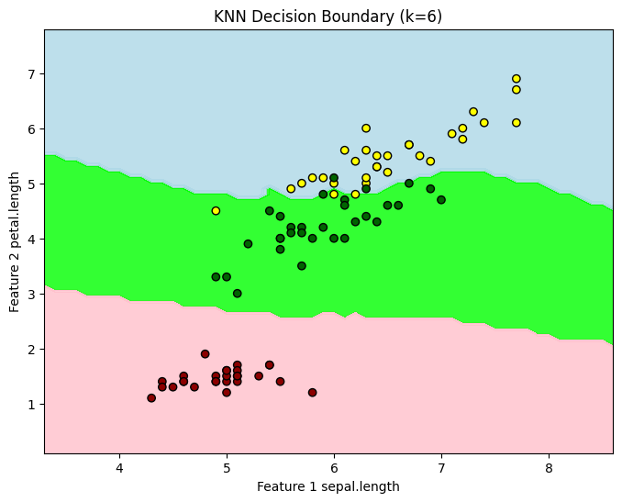
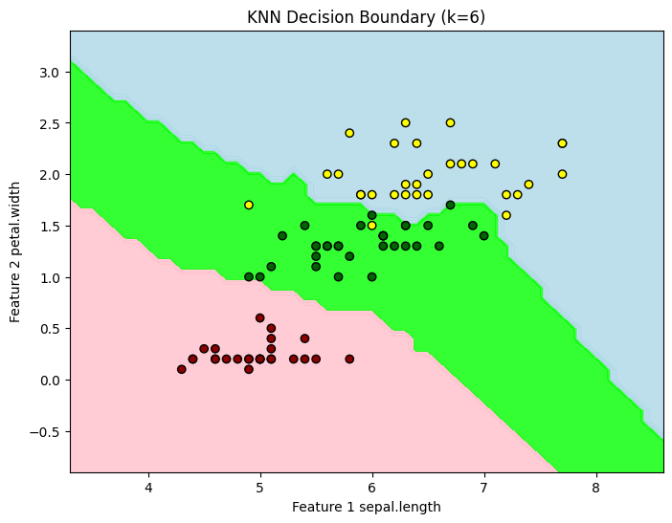
Example (Iris Dataset) K=6

Slide 23
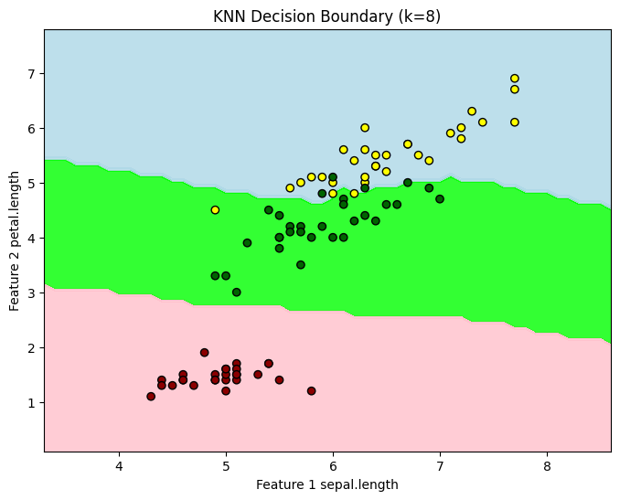
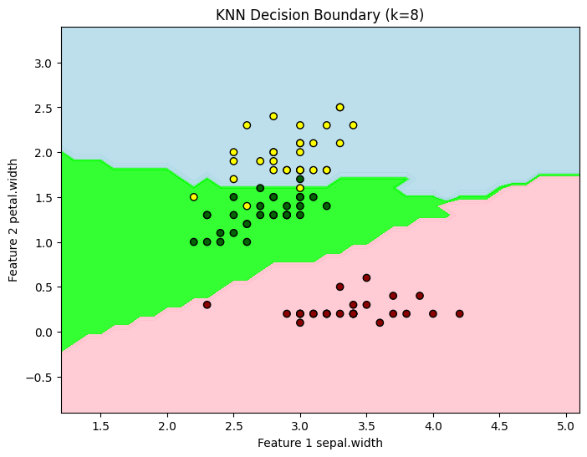
Example (Iris Dataset) K=8

Slide 24
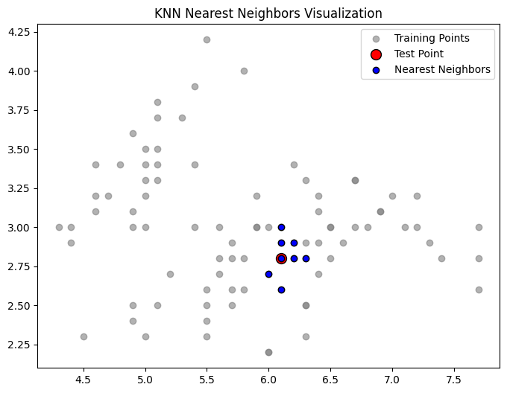
Example (Iris Dataset)

Slide 25
Python ipynb code + dataset
KNN Iris example python repo: HITEC_Codes/KNN_Algorithm at main · Mubshr07/HITEC_Codes
Make your GitHub account
give a star to this repo

Slide 26


Slide 27

Allah And The Cosmos (Channel: Beyond The Lote Tree)
URL: Allah And The Cosmos | Trailer
Number of episodes: 15

